Slide 1


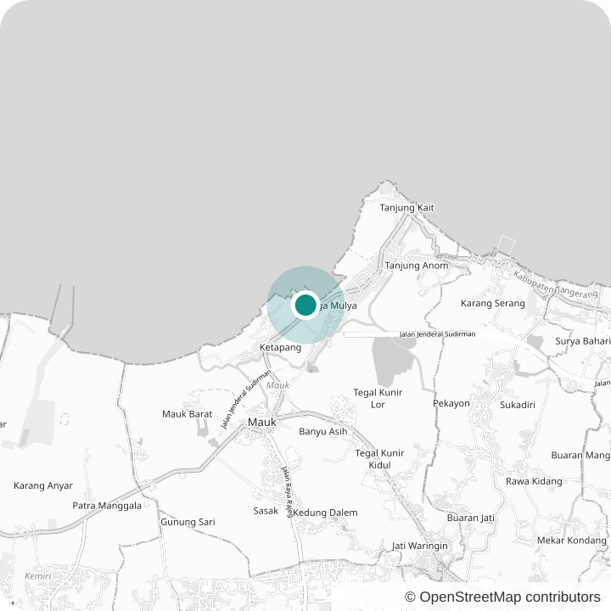



IIT Challenge logo
EcoQuest Web Application | IIT Challenge 2026
Desa Marga Mulya
Residents
The Digital Gateway for a Village
Local businesses
Kenali desanya. Akses layanannya. Dukung ekonominya.
Connect residents, local businesses, and people outside the village through one digital gateway.
Member 1
Member 2
Member 3
People outside
Notes:
Good morning. We are presenting Desa Marga Mulya — the digital gateway for a village. Marga Mulya is in Mauk, Tangerang. Our goal is simple: connect three groups through one digital gateway — the residents who live there, the local businesses who sell there, and the people outside the village who want to know it and support it. Our tagline says it in Indonesian: Kenali desanya, akses layanannya, dukung ekonominya — know the village, access its services, support its economy.

Slide 2

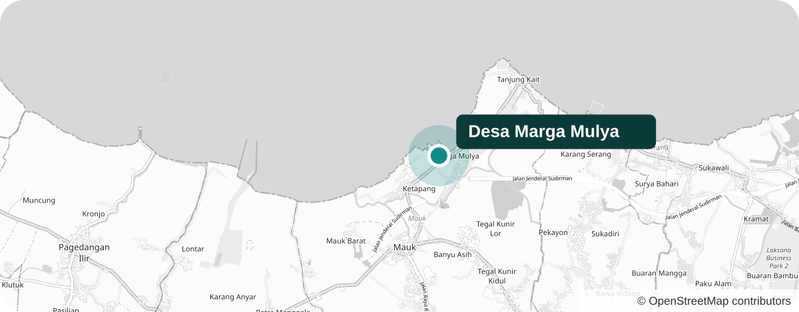



Overview
Problem
Solution
Demo
Impact
A Coastal Farming Village
Marga Mulya, Mauk, Tangerang
7,842
2,318
412 ha
residents
households
village land
55%
of land is rice fields & fish ponds
Marga Mulya is a coastal village shaped by agriculture, fisheries, community, and a growing local economy.
41%
of workers are in farming & fisheries
Agriculture
Fisheries
Community
Local economy
Village figures as currently entered in the website CMS — to be replaced with official BPS / village office figures. Map © OpenStreetMap contributors.
Notes:
First, who we are building for. Marga Mulya is a coastal farming village in Mauk, Tangerang — about seven thousand eight hundred residents in two thousand three hundred households, on four hundred twelve hectares. More than half of the land is rice fields and fish ponds, and four in ten workers are in farming and fisheries. So this is a village shaped by agriculture, fisheries, a close community, and a growing local economy.

Slide 3


Overview
Problem
Solution
Demo
Impact
Scattered, Not Missing
The village has information and potential — but it is hard to find, access, and use.
RESIDENT
1
BUYER OUTSIDE THE VILLAGE
2
PARTNER / RESEARCHER
3
“Who do I even ask about this?”
“What can I buy from this village?”
“Where is the data, and can I trust it?”
Services & requirements
Announcements & events
Village information
Local products
Who sells them
How to order
Demographics
Farming & fishery potential
Facilities & location
The problem is fragmentation, not absence.
74%
6 / 10
None
It lives in offices, chat groups, social media, and word of mouth — not in one place.
rural residents online
MSMEs still offline
official village website found*
Sources: APJII Internet Survey 2024 (rural internet use); GoodStats 2023 & Statista (27M of ~65M MSMEs digital). *Team web search, September 2026.
Notes:
The problem is not that the village has no information. It has services, products, and data — but they are scattered across the office, chat groups, social media, and word of mouth. A resident asks: who do I even ask? A buyer outside asks: what can I buy here, and how? A partner or researcher asks: where is the data, and can I trust it? Connectivity is not the barrier — 74 percent of rural Indonesians are online — yet six in ten small businesses are still offline, and we found no official village website. The problem is fragmentation, not absence.

Slide 4



Overview
Problem
Solution
Demo
Impact
One Gateway, Three Audiences
Not just a village website — a digital gateway.
RESIDENTS
LOCAL BUSINESSES
PEOPLE OUTSIDE
“I need something from the village.”
“I want more customers.”
“I want to know and support the village.”
Services & checklists
Pasar Desa marketplace
Interactive map
Live office status
Seller portal
Explore by category (next)
Announcements
WhatsApp orders
Open village data
AI assistant
Local products
FOUR PILLARS
SERVE
DISCOVER
BUY
UNDERSTAND
Live
Map live
Live
Live
Categories next
Live now
Planned next (not yet built)
Notes:
Our answer is not just a village website — it is a digital gateway with three audiences. Residents get services with requirement checklists, live office status, announcements, and an AI assistant. Local businesses get the Pasar Desa marketplace, a seller portal, and WhatsApp orders. People outside get an interactive map, open village data, and local products. It rests on four pillars: Serve, Discover, Buy, and Understand. To be clear: everything with a filled dot is live today; explore-by-category is our next step.

Slide 5
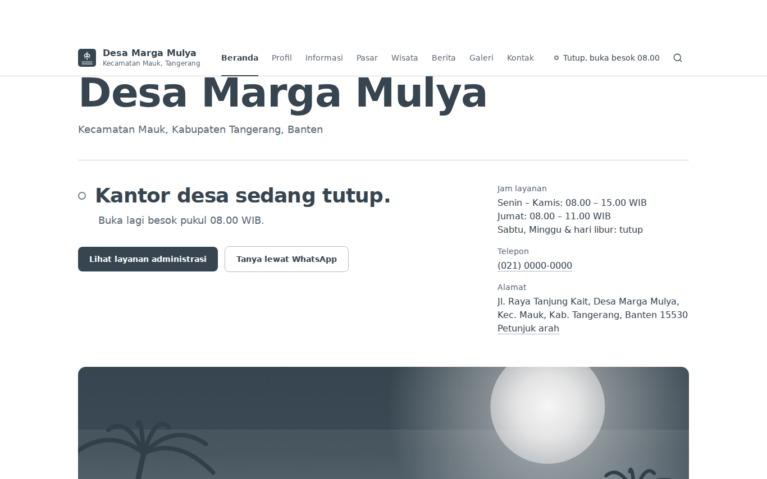
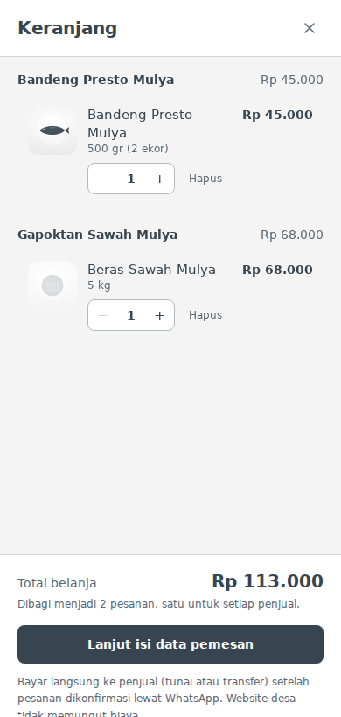
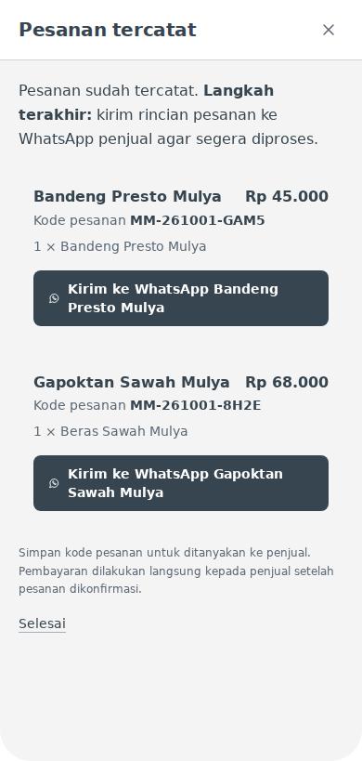
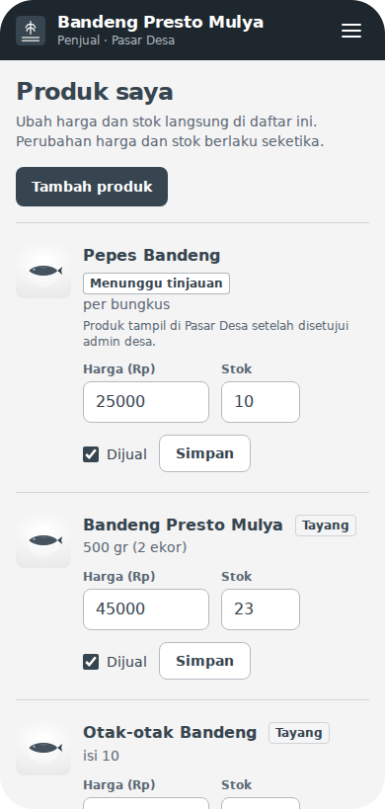









Overview
Problem
Solution
Demo
Impact
Built and Live
Live demo: desa-marga-mulya.vercel.app
Home
›
Service
›
Pasar Desa
›
Product
›
Cart
›
WhatsApp Order
›
Seller Portal
Home — live office status & services
Multi-seller cart
WhatsApp order
Seller portal
Also live: service checklists · Tanya Desa AI assistant · 42 open data tables with CSV · interactive map · CMS for village staff
Next.js
React
TypeScript
Tailwind
PostgreSQL
Vercel
Gemini AI
Leaflet
CI tests
Notes:
This is all built and live. A resident opens the home page and sees right away whether the village office is open, then picks a service and gets its requirement checklist. A buyer opens Pasar Desa, picks a product, and adds it to the cart — one cart can hold products from several sellers. At checkout it becomes one WhatsApp order per seller, each with its own order code. Sellers manage price and stock from their phone in the seller portal, and new products are reviewed by the admin first. The AI assistant and 42 open data tables are live too.

Slide 6






Overview
Problem
Solution
Demo
Impact
A Practical Win-Win-Win
Impact & implementation feasibility
RESIDENTS
BUSINESSES
VILLAGE
24/7
information access
0%
platform commission
1
hub for village information
Easier access to services
0% platform commission
Centralized information
Fewer unnecessary trips
Digital visibility
CMS-managed content
24/7 information access
Simple WhatsApp ordering
Open village data
Feasible
today
Rp 0
PostgreSQL
CMS
109
monthly hosting on the current free-tier setup
reliable, managed database
11 content collections, no coding needed
automated checks, all passing
Hosting cost reflects the current free-tier setup; it may change as usage grows.
Notes:
The impact is a practical win for everyone. Residents get easier access to services, fewer unnecessary trips, and information any time of day. Businesses pay zero platform commission, gain digital visibility, and take orders through the WhatsApp they already use. The village gets one central place for its information, managed through a CMS, with open data. And it is feasible today: Rp 0 monthly hosting on our current free-tier setup, a PostgreSQL database, a CMS with eleven content collections that staff can use without coding, and 109 automated checks.

Slide 7


IIT Challenge logo
One Gateway for the Whole Village
Residents access services.
Businesses reach customers.
People outside discover and support Marga Mulya.
Scan to try the live demo
Kenali desanya. Akses layanannya. Dukung ekonominya.
desa-marga-mulya.vercel.app
10
42
16
Thank you
public pages
data tables
local products
Notes:
To close: one gateway for the whole village. Residents access services. Businesses reach customers. People outside discover and support Marga Mulya. Ten public pages, forty-two data tables, and sixteen local products are already live — scan the code to try it yourself. Kenali desanya, akses layanannya, dukung ekonominya. Thank you.

